Slide 1
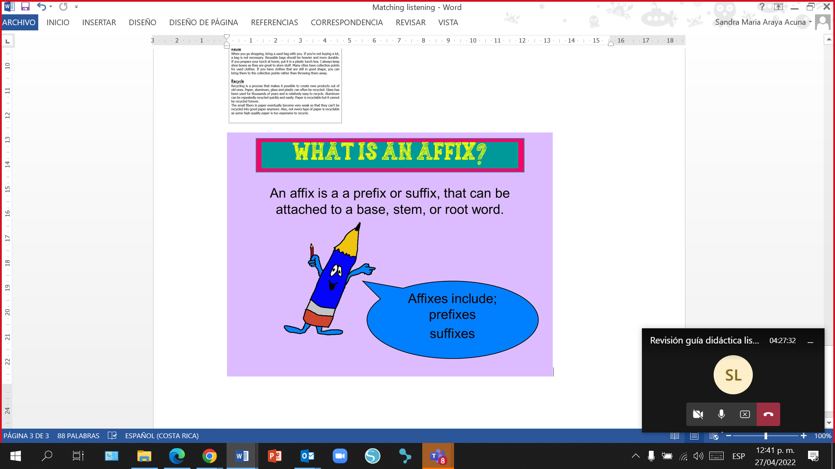

Slide 2

a b l e
able to
Recyclable

Slide 3
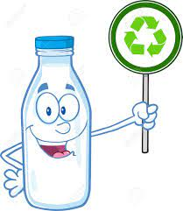
e d
already happened
Recycled

Slide 4
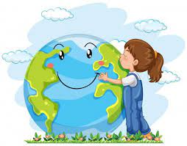
i n g
happening now
Protecting

Slide 5
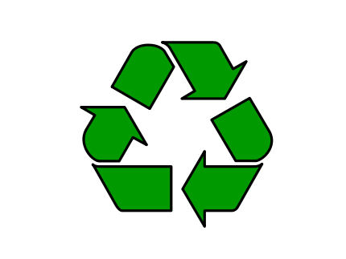
r e
again
Recycle

Slide 6
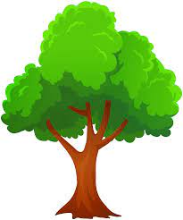

s
more than one (plural)
trees

Slide 7

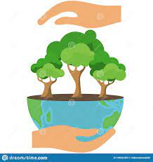
s
3rd Person Singular
Recycle protects trees

